Slide 1
COMPUTER SKILLS
Use of Operating System
( Windows 10 )

Slide 2

What is OS?

Slide 3
Windows 10: What’s New?

Slide 4
Windows 10
The biggest changes, including:
How to use the new Start menu.
Understand notifications and the Action center.
How to use Window’s digital assistant, Cortana.
Microsoft Edge, Windows new web browser.
How to use multiple desktops.
How to use Windows 10 on a tablet.
Understanding Windows 10 settings.
Quick Access Section

Slide 5
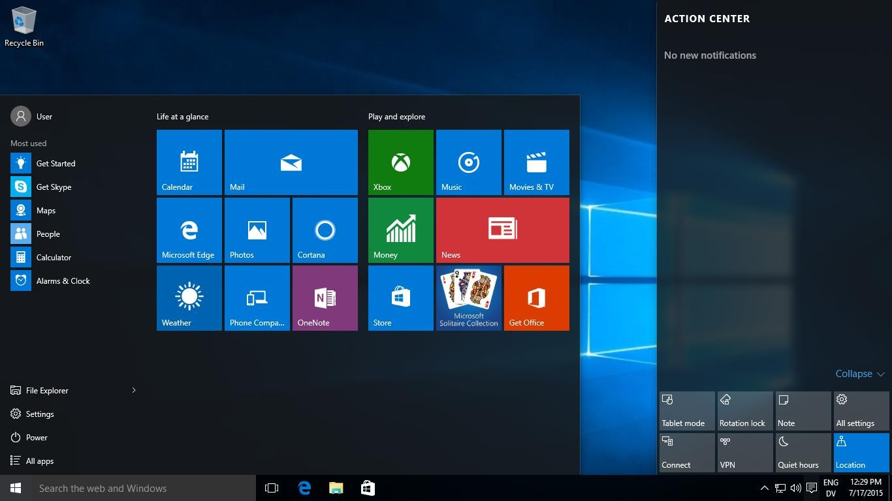
EXPLORE THE OS INTERFACE
icons
Desktop
Menu
Task bar
Start button

Slide 6

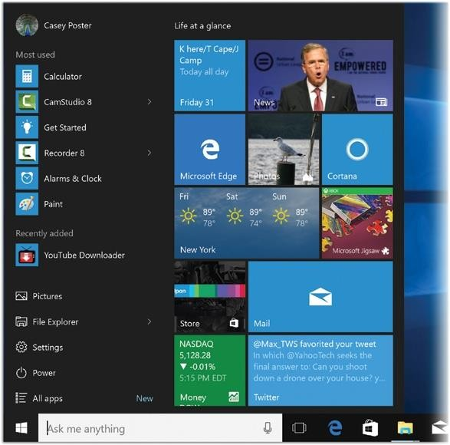
EXPLORE THE START MENU
Click on the start button
Start menu is split into two columns. let’s
call them the left side and the right side.
Hybrid Start menu: The left side gives you direct access to apps you use frequently, or that you’ve installed recently, as well as important commands and places like power and “All apps.” The right side is yours to customize."

Slide 7
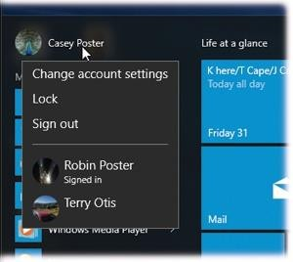
LEFT SIDE OF START MENU
See your account name and picture in the upper-left corner of the Start menu
it’s also a pop-up menu. Click it to see the “Sign out” and “Lock” commands, as well as a shortcut to your account settings.
Change account settings: takes you directly to the Settings→Account screen, where you can change your account picture, password, and other details of your account.
Lock: takes you back to the Lock screen. It is hiding your screen from view. This is an ideal way to protect your PC from nosy people. Whatever you had running remains open behind the scenes
Sign out: When you choose “Sign out,” Windows closes all your open programs and documents.

Slide 8
LEFT SIDE OF START MENU
Most Used : you get a list of the programs that Windows sees you using a lot
Recently Added : whatever app you’ve most recently downloaded or installed
If you want to hide the “Recently added” . Open the Start menu; choose Settings→Personalization→Start; turn off “Show recently added apps.” Close Settings.
Important Places : the left side listing the important places on the computer. Like:
File Explorer, Setting , Power , All apps

Slide 9
RIGHT SIDE OF START MENU
Make the right side bigger or smaller
Make the right side fill the screen
Move a tile
Resize a tile
Add new tiles
The drag method
The right-click method

Slide 10
START SCREEN
To switch between the default and full-screen Start screen
Open the Settings window.
Click Personalization, and then on the Personalization page, click Start.
In the Start pane, click Use Start full screen. Then click the Start button to test the setting.
To resize the partial-screen Start screen
Do any of the following:
Drag the top border of the Start screen up or down to increase or decreas e its height.
Drag the right border of the Start screen right or left to increase or decrea
se its width.

Slide 11
TASKBAR
A bar located at the bottom of the screen. It allows you to locate and launc
h programs.
The Windows taskbar has four main sections:
Start Button (labeled with "Start" and the Windows logo)
Quick Launch (allowing applications to be launched with a single click) 3.Running Programs (allowing easy access to running programs) 4.Notification Area (contains icons for small running programs such as the clo ck, calendar and volume control)

Slide 12
TASKBAR
prevent or allow changes to the taskbar
move the taskbar
change the taskbar height
display small taskbar buttons
hide the taskbar when it isn’t active
change the display of multiple app taskbar buttons

Slide 13
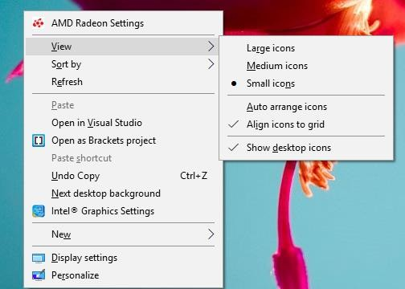
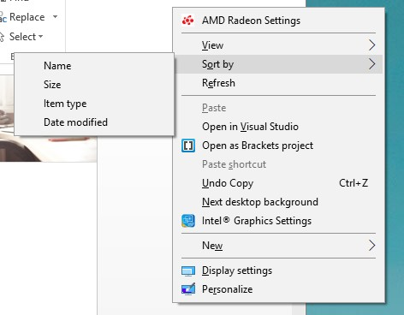
CUSTOMIZE THE DESKTOP ICONS

Slide 14
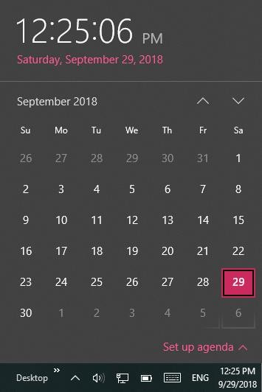
DATE AND TIME
Change :
Directly
Through Control Panel

Slide 15
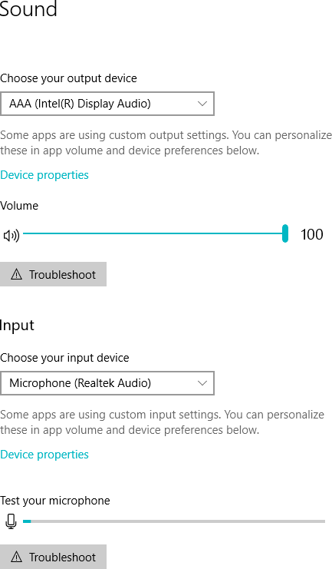
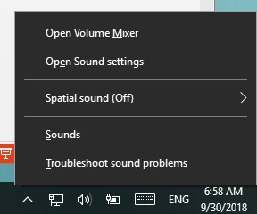
SOUND SETTING

Slide 16
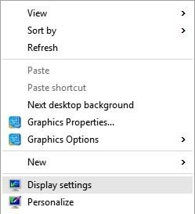
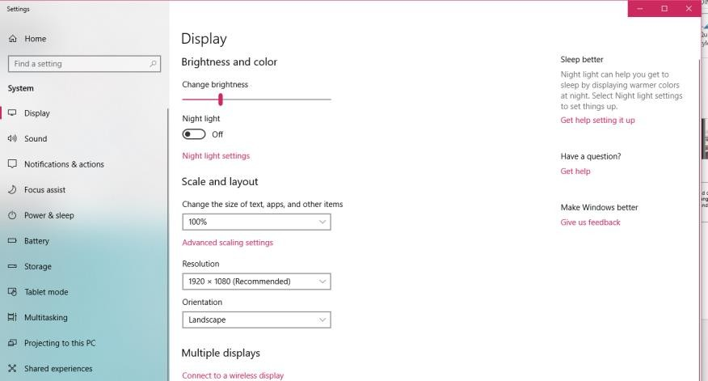
DISPLAY SETTING
Go to your Desktop, right-click your mouse and go to Display Settings.
The following panel will open. Here you can adjust the size of text, apps, and other items and also change the orientation. To change the resolution settings, scroll down this window and click on Advanced Display Settings.

Slide 17
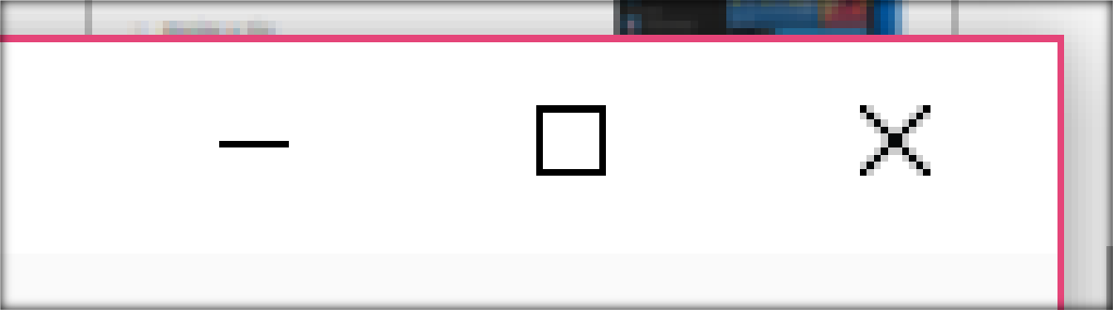
MINIMIZE , MAXIMIZE , CHANGE , CLOSE THE WINDOWS
If you want to resize both horizontally and vertically, use one of the corners of the window.

Slide 18
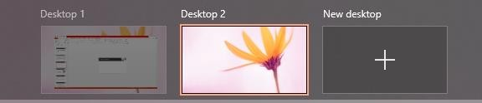
ADD ANOTHER DESKTOP

Slide 19
Arrange the Program Windows
Cascading windows is a type of arrangement of applications that are ope n on a Windows desktop. In this arrangement, the windows of the currently r unning applications overlap each other and their title bars are made visible to let the user know their open status. The cascading window arrangement can be used to manage multiple windows which are open simultaneously.

Slide 20
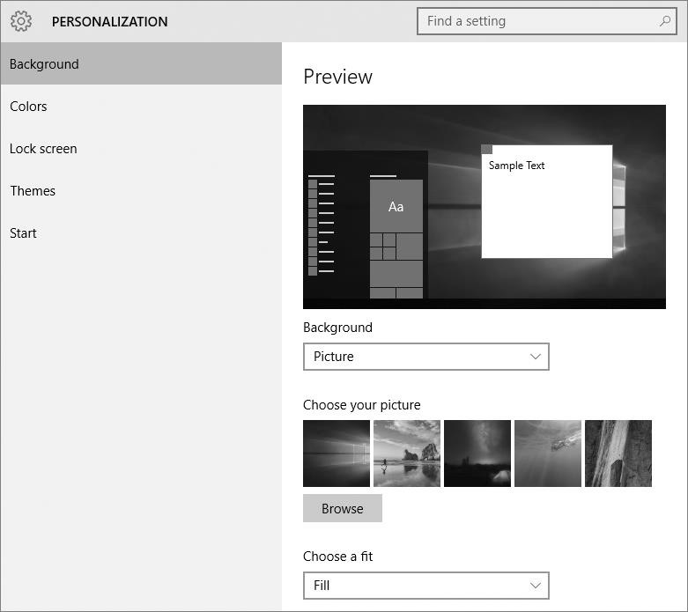
SET THE DESKTOP BACKGROUND AND SYSTEM COLORS
we can use the options in the Personalization category of the Settings window to set the d esktop background and the accent color th at is used for various operating system ele ments, including the Start menu, taskbar, Act ion Center, and window title bars.

Slide 21
SET THE DESKTOP BACKGROUND
You can set your desktop background to any of the following:
A picture : You can choose one of the photos that come with Windows, or a digital image of your own. The image can be any of several file types, including GIF, JPG, PNG
… etc
A solid color : If you want to keep things simple, you can use for a plain, colored background.
A slideshow : You can display the contents of a folder of your choice, with the background image changing as frequently as every minute or every 10 min. , 30 min., hour, six hours, or day.

Slide 22
SET THE DESKTOP BACKGROUND
When displaying an image or slideshow as your desktop background, you can specify the position of the image as follows:
Fill : The image is centered on the screen. The image fills the screen horizontally and vertically, and maintains its original aspect ratio. Parts of the image might overrun the left and right sides or the top and bottom edges (but not both).
Fit : The image is centered on the screen. The image fills the screen horizontally or ver tically, and maintains its original aspect ratio. Parts of the image might not fill the left and right sides or the top and bottom edges.
Stretch : The image is centered on the screen. The image fills the screen horizontally and vertically, but does not maintain its original aspect ratio. No part of the image over runs the screen.

Slide 23
SET THE DESKTOP BACKGROUND
When displaying an image or slideshow as your desktop background, you can specify the position of the image as follows:
Tile : The image is anchored in the upper-left corner of the screen at its original size, followed by as many copies as are necessary to fill the screen. Parts of the right-most and bottom tiles might overrun the edges of the screen.
Center : The image is centered on the screen at its original size.
Span : When you have multiple monitors connected to the computer, this option
stretches the image across the monitors.

Slide 24
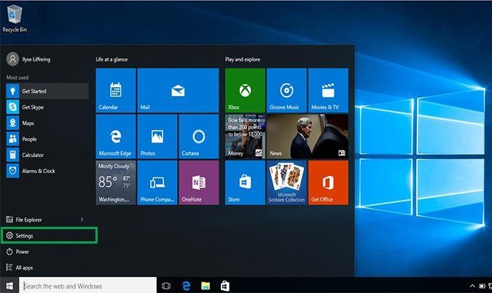
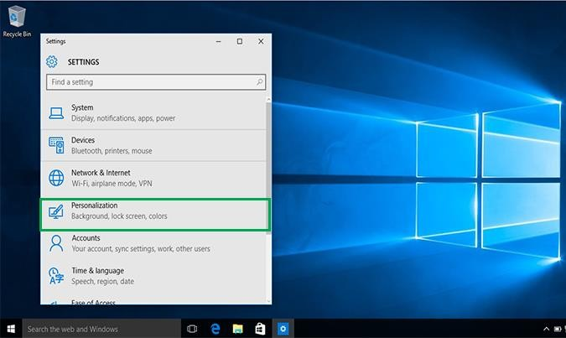
SET THE DESKTOP BACKGROUND
1. Click on Settings in the list on the left.
2. Click on Personalization, fourth on the list.

Slide 25
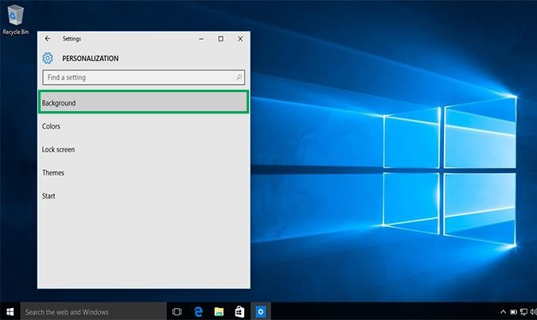
SET THE DESKTOP BACKGROUND
3. Click on Background. The background page will come up which allows you to preview your background picture and lets you choose from several photos or your own photos for your desktop background.

Slide 26
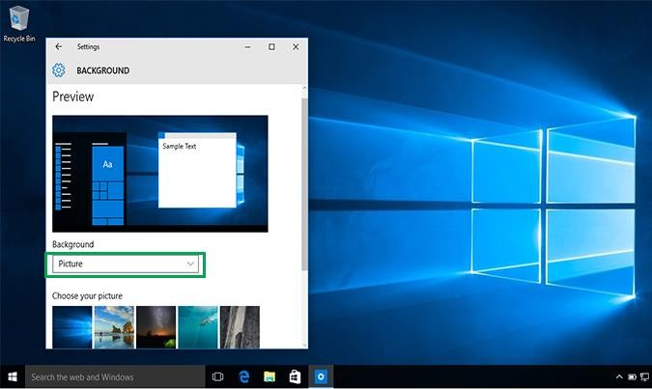
SET THE DESKTOP BACKGROUND
4. Click on the box underneath Background to choose between a picture, solid color, or slideshow for your background.

Slide 27
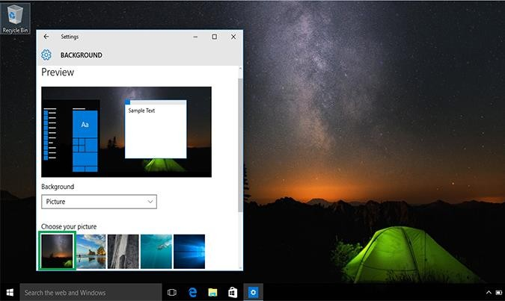
SET THE DESKTOP BACKGROUND
5. Underneath Choose your picture, click on one of the options or click Browse
to choose one from your computer. Click on whatever photo you want and it will appear as your desktop background.

Slide 28
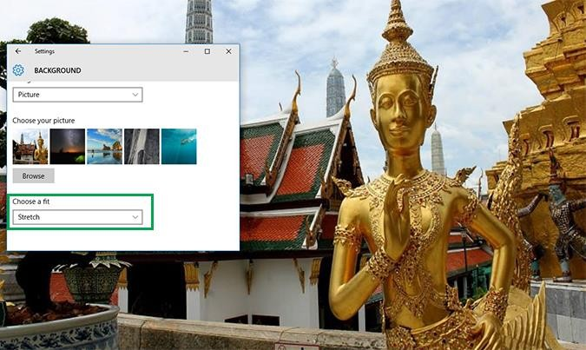
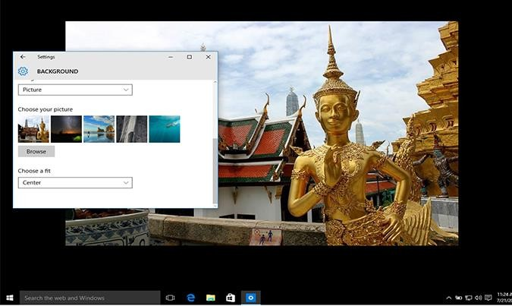
SET THE DESKTOP BACKGROUND
. If you don't like the layout of the photo you can click on the box underneath Choose a fit to choose between fill, fit, stretch, tile, or center options for your background.

Slide 29
THE SLEEP/SHUT DOWN/RESTART COMMANDS
Sleep : take a break without closing all your programs or shutting down the computer. you can trigger Sleep by pushing the PC’s power button or move the mouse.
Restart : This command quits all open programs and then quits and restarts Windows again automatically. The computer doesn’t actually turn off. You might do this to “refresh” your computer when you notice that it’s responding sluggishly
Shut down “really, really off” : When you shut down your PC, Windows quits all open programs, offers you the opportunity to save any unsaved documents, exits Windows, and turns off the computer.

Slide 30
MOUSE PROCESURE
the Mouse Clicking
Single-clicking often selects an item or opens a menu.
Double-clicking often opens items ( Files or programs ) or folders.
Right-clicking usually displays a list of things you can do with a selected item.

Slide 31
MOUSE PROCESURE
Scrolling and dragging items with the mouse
Move the wheel with your pointer finger to scroll up and down pages.
To drag an object, place the cursor on it, then press and hold down the right button, and move the mouse to a new location. Release the right button once you are done.

Slide 32
SUMMERY OF THE MOUSE USES :
Opening a file or program
Selecting object and highlighting text
Drag-and-drop
Viewing properties by right-clicking
Copy and paste

Slide 33
SHORTCUTS
Desktop Shortcuts
Keyboard Shortcuts
The most popular place to have a shortcut is the desktop area. It is very highly recommended that you create shortcuts to any documents, folders, and programs that you often use and place them on the desktop. Locate the program (or file, or fol der) that you want to add a desktop icon for.
combine the Ctrl or Alt keys with some other keys which invokes commands in software. Most keyboard shortcuts require the user to press
a single key or a sequence of keys one after the other. Other keyboard shortcuts require pressing and holding several keys simultaneously

Slide 34
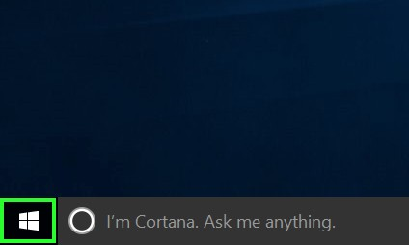
DESKTOP SHORTCUTS
1. Select the Windows button to open the Start menu.

Slide 35
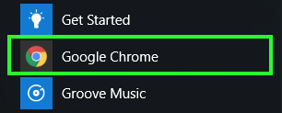
DESKTOP SHORTCUTS
2. Right-click on the app you want to create a desktop shortcut for.

Slide 36
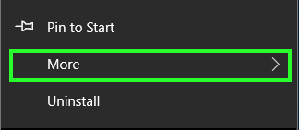
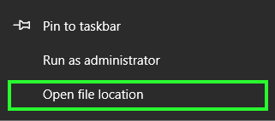
DESKTOP SHORTCUTS
5. Select Open file location. If this option does not appear,
this app is a Modern app, so you'll want to use the second set of instructions.
4. Select More.

Slide 37
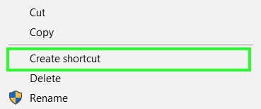
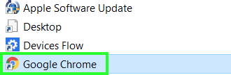
DESKTOP SHORTCUTS
6. Right-click on the app's icon.
7. Select Create shortcut.

Slide 38
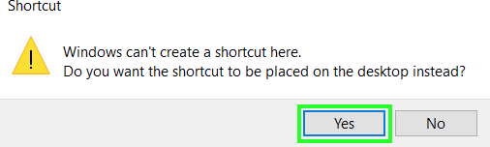
DESKTOP SHORTCUTS
8. Select Yes.

Slide 39
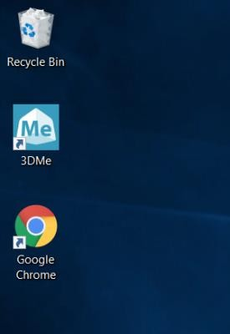
DESKTOP SHORTCUTS
You've got a desktop shortcut for your Desktop program!

Slide 40
KEYBOARD SHORTCUTS
Common Shortcut Keys :
Ctrl and A: Selects all in Screen.
Ctrl and C: Copies the item or text.
Ctrl and F: Displays the Find dialog box to search the current document.
Ctrl and S: Saves a document.
Ctrl and V: Pastes the copied item or text.
Ctrl and X: Cuts the selected item or text.
Ctrl and Z: Undo the last action.

Slide 41
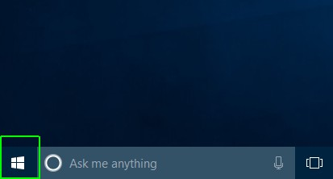
INSTALLING AND UNINSTALLING APPLICATIONS
Uninstalling the Application:
Uninstalling unwanted programs is one of the most common and important tasks that all PC users perform.
Open the Start menu.

Slide 42
INSTALLING AND UNINSTALLING APPLICATIONS
Uninstalling the Application:
Uninstalling unwanted programs is one of the most common and important tasks that all PC users perform.
Open the Start menu.

Slide 43
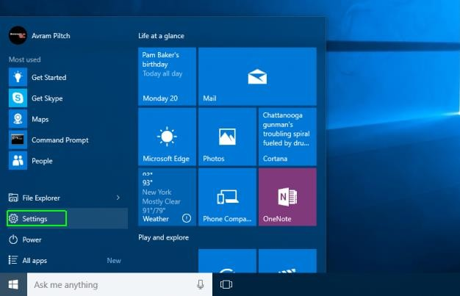
INSTALLING AND UNINSTALLING APPLICATIONS
2. Click Settings.

Slide 44
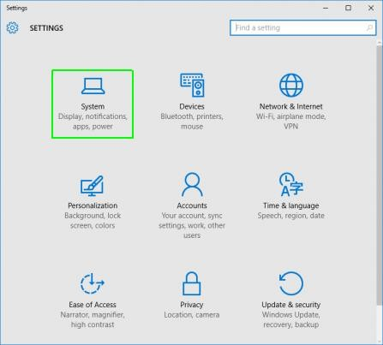
INSTALLING AND UNINSTALLING APPLICATIONS
3. Click System on the Settings menu.

Slide 45
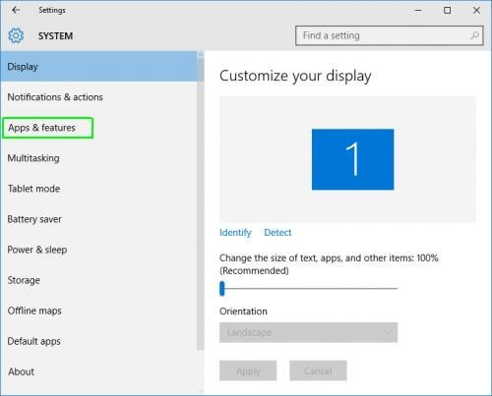
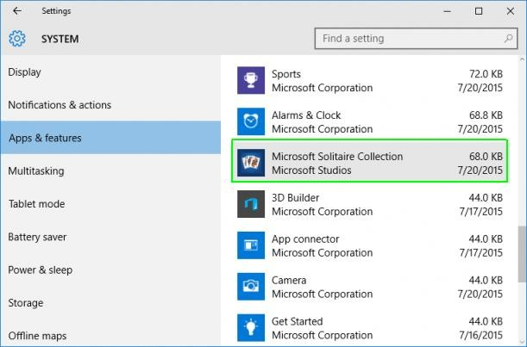
INSTALLING AND UNINSTALLING APPLICATIONS
4.Select Apps & features from the left pane.
5.Select an app you wish to uninstall.
A list of all installed apps appears in the right pane
.

Slide 46
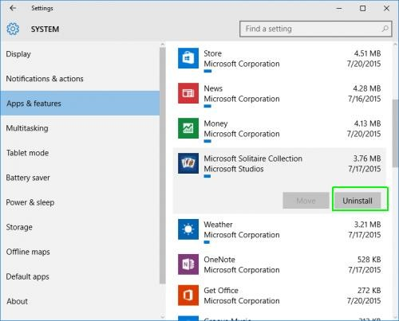
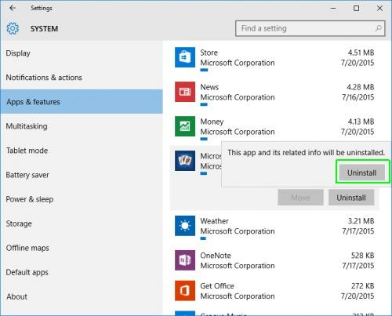
INSTALLING AND UNINSTALLING APPLICATIONS
6. Click the Uninstall button that appears. If it is grayed out, this is a system app you cannot remove.
7. Click the Uninstall pop-up button to confirm.

Slide 47
Files,
Folders, Disks

Slide 48
WHAT IS A FILE?
Files are collections of information. In fact, almost all of the informatio n stored in a computer is stored in files. There are many different types o f files, including operating system files, program files, and more.
Each file is given a file name and has a three-letter
file name extension that identifies the file type.
Name extension are separated by a period

Slide 49
WHAT IS A FILE?
Some common file name extensions include:
doc or docx: Word or WordPad document
jpg or jpeg: Picture file
txt: Notepad text file
xls or xlsx: Excel spreadsheet
htm or html: HTML file (webpage)
ppt: PowerPoint presentation
mdb or accdb: Access database

Slide 50
CREATING, RENAMING, AND DELETING FILES
you can create a file using different programs such as WordPad or Notepad.
Click Start.
Choose All Programs  Notepad. 3.Notepad opens.
Type, "This is my new document".
Choose File Save from the menu bar (Ctrl + S).
The Save As dialog box appears.
Save your file to the desktop.
Name your document new document.
In the Save as type drop-down box, be sure your document is saved as a text document.
Click Save. Your file is now saved to the desktop.

Slide 51
CREATING, RENAMING, AND DELETING FILES
To rename a file:
Locate your file (in this case, the file is located on the desktop).
Right-click the file icon.
Choose Rename.
The filename is highlighted in blue, ready to be retyped.
Type a new name, then press Enter.
The file is renamed.

Slide 52
CREATING, RENAMING, AND DELETING FILES
To delete a file:
Locate your file (in this case, the file is located on the desktop).
Right-click the file icon.
Choose Delete.
A Confirm File Delete dialog box appears asking you if you are sure you want to send the file t o the Recycle Bin.
Choose Yes.
The file is moved to the Recycle Bin.

Slide 53
WHAT IS A FOLDER?
When you first start using Windows 10, you may only create a few files. Over
time, you'll create MANY files. To keep your files organized, create folders.
Windows 10 uses various folders to store and manage files.
Method 1: Create a New Folder with a Keyboard Shortcut
The fastest way to create a new folder in Windows is with the CTRL+Shift+N shortcut.
Navigate to the location where you want to create the folder. You can create a new fold er at any location on your hard drive or within another folder (creating a subfolder) in File Ex plorer. You can also create a new folder on your desktop with this method.
Hold down the Ctrl, Shift, and N keys at the same time. Windows will immediately create the new folder with the not-very-imaginative suggested folder name of "New folder."

Slide 54
CREATING, RENAMING, AND DELETING FOLDERS
Method 2: Create a New Folder by Right-Clicking
Navigate to the location where you want to create the folder.
Right-click on a blank space in the folder location. Take care with this: If you right-click on an existing item in the folder, you'll get the wrong menu.
Select New then Folder from the contextual menu. Windows will create the new folder at your current location.
Method 3: Create a New Folder from the Ribbon Menu
Another simple way to create a new folder is to use the New folder button in the File Explorer menu.
Just navigate to the place you want the folder and click or tap "New folder" in the Home tab

Slide 55
ALL WINDOWS 10 FOLDERS INCLUDE THE FOLLOWING FEATURES:
Title bar: Contains the name of the folder
Menu bar: Contains the File, Edit, View, Favorites, Tools, and Help menus
Navigation bar: Contains the Back, Forward, Up, Search, Folders, and Views buttons
Address bar: Shows current folder location (use the drop-down arrow to navigate your computer's places)
White space: Displays contents of a folder (folders and files)
File and Folder Tasks list: A convenient list of tasks
Other Places: A convenient list of your computer's places
Details: Describes the folder

Slide 56
CREATING, RENAMING, AND DELETING FOLDERS
To rename a folder:
Locate your folder.
Right-click the folder icon.
Choose Rename.
The folder name is highlighted in blue, ready to be retyped.
Type a new name, then press Enter.

Slide 57
CREATING, RENAMING, AND DELETING FOLDERS
To delete a folder:
Locate your folder.
Right-click the folder icon.
Choose Delete.
A Confirm Folder Delete dialog box appears asking you if you are sure you want to send the file to the Recycle Bin.
Choose Yes.
The folder is moved to the Recycle Bin.

Slide 58
WHAT IS A DRIVE?
A drive, or disk drive, is hardware on which you can store files and folders.
Disk drives are assigned a letter.
Your hard drive (the drive inside your computer) is known as the (C:) drive.
Your floppy disk drive is known as the (A:) drive.
If your computer has a CD-ROM drive, it is usually called (D:).

Slide 59
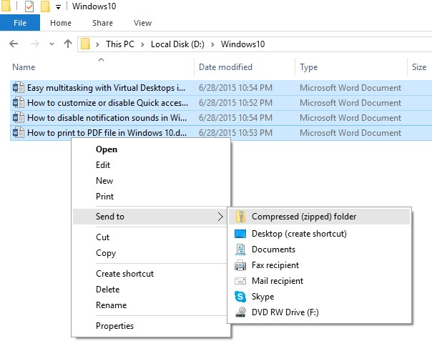
HOW TO ZIP AND UNZIP FILES IN WINDOWS 10
Windows 10 comes with native support for files compression and uncompression using which you can easily compress(zip) and uncompress (unzip) files or folders on your Windows computer.
Zip (compress) files or folders in Windows 10
Open FileExplorer. Select and right click file(s) or folder(s) that you want to zip. In context menu, select "Send to -> Compressed (zipped folder)". This will compress your selected file(s) or folder(s) to new .zip file in current folder.

Slide 60
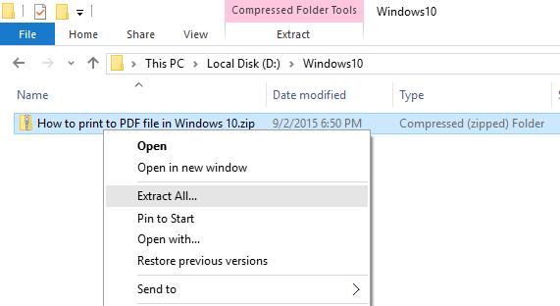
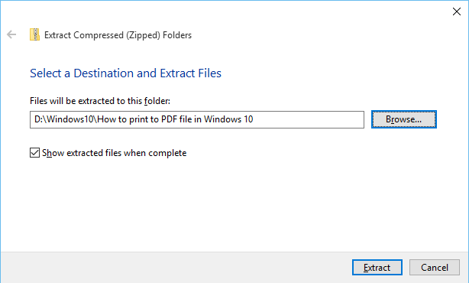
HOW TO ZIP AND UNZIP FILES IN WINDOWS 10
Unzip files in Windows 10
Right click on .zip file that you want to unzip
(uncompress), and click on "Extract All" in context menu.
In "Extract Compressed (Zipped) Folders" dialog, enter or browse folder path where you want files to be extracted. Check "Show extracted files when complete" checkbox to
open extracted folder after zip extraction is complete. Click on "Extract" button to start the extraction.

Slide 61
PARTITIONS AND VOLUMES: AN OVERVIEW
Before we can make use of this space, e.g. to install Windows, we need to create one or more partitions.
Partitions are segmented portions of storage space
Volumes are partitions formatted with a single file
With Windows, you’ll typically see drives formatted with NTFS (New Technology File
System).
On removable drives, you’ll commonly find FAT32 (File Allocation System) or exFAT.
If you have two separate partitions (on the same or two different drives) in your PC and b oth formatted with a file system, both will be labeled with different letters. Typically, you’ ll have a C: and the D: drive. These two drives are volumes

Slide 62

PARTITIONS AND VOLUMES: AN OVERVIEW
let’s look at how you can shrink, merge, and clear partitions in Windows 10.
This will let you add or subtract space from your partitions.
Before manipulate your partitions, you should first defragment hard drive. This will gather all your data in a single chunk of space.

Slide 63
PARTITIONS AND VOLUMES: AN OVERVIEW
To defragment your hard drive, press Windows + S, type defrag, and
select Defragment and Optimize Drives from the results. Here you can optimize or defragment your drives. Note that Windows may be set up to do this automatically.
Once you’ve analyzed and defragmented your hard drive, you’ll note the data
displayed in your software gathers to one section.
The remaining, blank space is what partitioning management tools will use in order to create new partitions. If your data is scattered across the drive, you will not be able to manage the storage space as it’s counted with the original partition.

Slide 64
PARTITIONS AND VOLUMES: AN OVERVIEW
Disk Management
To open Windows 10’s Disk Management program, press Windows + S, type partition, and select the Create and format hard disk partition option. In the following window, you’ll see both your partitions and volumes laid out in distinct blocks according to your different hard drives.
You’ll note that the categories above display a series of parameters,
particularly Capacityand Free Space. You cannot shrink, or separate, a chunk of storage larger
than the free space of your hard drive. Even then, you may not be able to separate the exact free space of your storage because some of the data may be scattered.

Slide 65
PARTITIONS AND VOLUMES: AN OVERVIEW
Shrink a Volume
If you have free space on your drive, you can shrink a volume in order to create a separate partition. Right-click on a volume and select Shrink Volume. This will analyze your remaining free space,
and prompt you to input how much space you want to shrink (i.e. separate) your volume by.
Once you’ve shrunk your volume, you should now be able to see a black space labeled Unallocated in your Disk Management window.
That’s it! You’ve successfully shrunk a partition.

Slide 66
PARTITIONS AND VOLUMES: AN OVERVIEW
Create a Separate Volume
Now that we have a bit of unallocated space, we can create a separate volume. Right-click on your Unallocated space and select New Simple Volume. Follow the Wizard, assign your
drive letter, and format this volume into either NTFS or FAT32.
Now, you can use this E: drive in the same way you would a separate hard disk or flash drive. To change the drive letter of this drive, simply right-click the space, select Change Drive Letter and Paths, and follow the wizard. To delete, right-click the Volume and select Delete Volume. Your volume will then revert back to unallocated space.

Slide 67
PARTITIONS AND VOLUMES: AN OVERVIEW
Format a Volume
At times, you may want to format a volume with a different file system, so you can use it across various operating systems. To do so, right-click on a volume and select Format. In the following window, choose which file type you’d like to incorporate to your volume.
NTFS: file system for Windows, you can write and view any files you’d like through Windows in
this file format.
FAT32: file system for USB drives, FAT32 will allow you to write data from any OS onto this file type. You cannot, however, load individual files larger than 4 GBs onto this file format.
REFS: The newer file format of the three grants better protection against file corruptions, may work faster, and maintains a few more benefits like larger volume sizes and file names than its older NTFS counterpart. REFS, however, cannot boot Windows.

Slide 68
PARTITIONS AND VOLUMES: AN OVERVIEW
Extend a Volume
When you have a bit of unallocated space, you shouldn’t leave that space unused. After all, more space is always better. To expand the storage on your volume using unallocated space, right-click on
your existing volume, in my case the D: drive, and select Extend Volume. Follow the Wizard: it
should select your unallocated space by default.
Keep in mind, you can only extend your volume size with unallocated space displayed to the right of your volume within the Windows 10 Disk Management software.
The process is simple enough and will allow you to use all of your unallocated space.

Slide 69
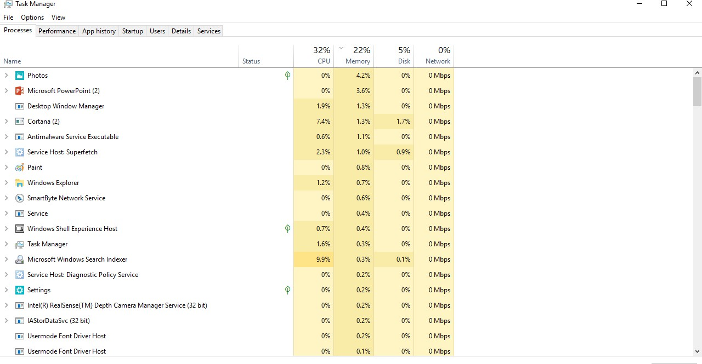
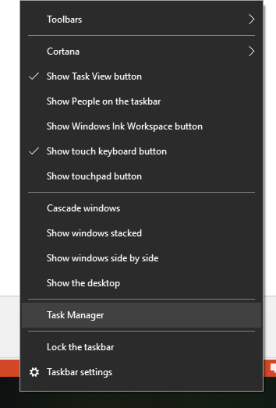
Files Search , Task Manager , Help

Slide 70
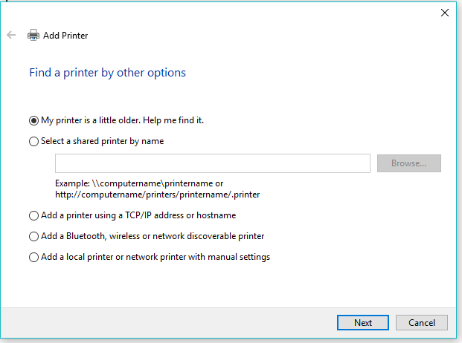
Printers

Slide 71
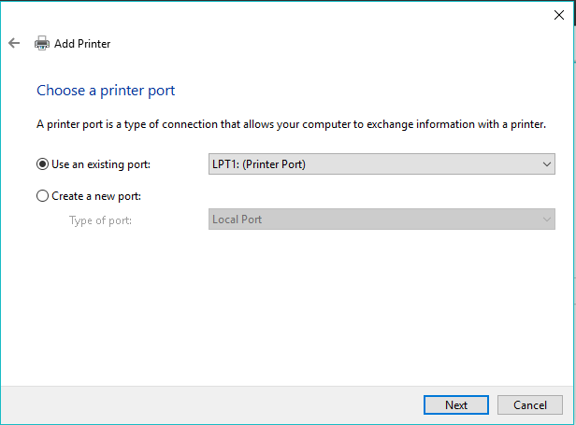
Printers

Slide 72
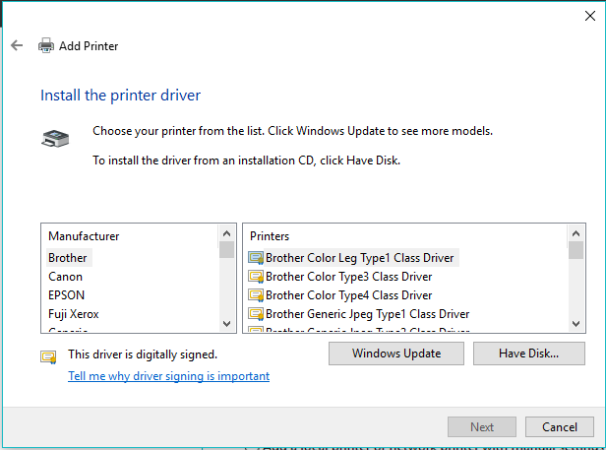
Printers

Slide 73
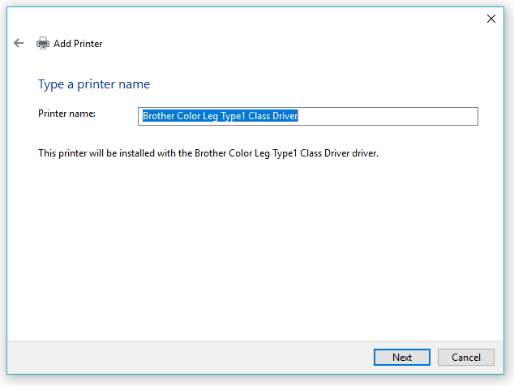
Printers

Slide 74
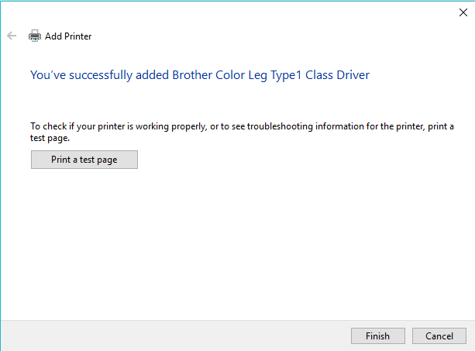
Printers

Slide 75
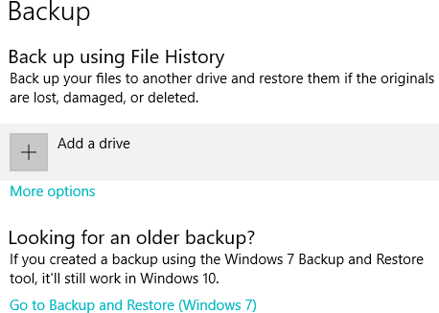
Backup

Slide 76
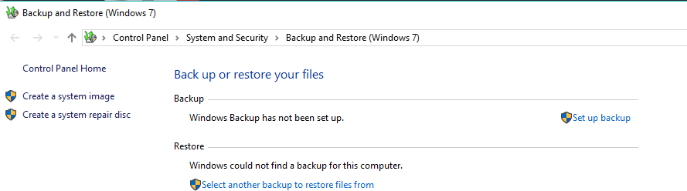
Backup

Slide 77
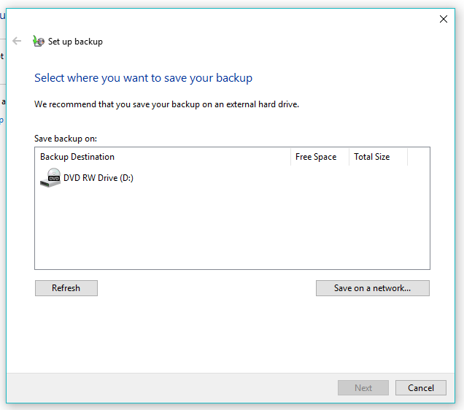
Backup

Slide 78
OPERATING SYSTEM UTILITIES
Using the PRINT SCREEN key
Pressing PRINT SCREEN captures an image of your entire screen and copies it to the Clipboard in your computer's memory. You can then paste (CTRL+V) the image into a document, email message, or other file.
Where is the PRINT SCREEN button?
The PRINT SCREEN key is usually located in the upper right corner of your keyboard. The key looks similar to the following:
The text you see on your keyboard might be PrtSc, PrtScn, or PrntScrn.

Slide 79
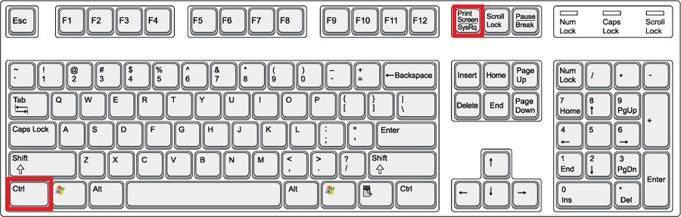
PRINT SCREEN

Slide 80
OPERATING SYSTEM UTILITIES
Using the PRINT SCREEN key
Click the window that you want to copy.
Press ALT+PRINT SCREEN.
Paste (CTRL+V) the image into an Office program or drawing application, such as Paint

Slide 81
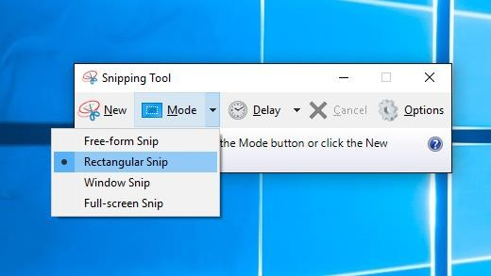
OPERATING SYSTEM UTILITIES
Use Snipping Tool to capture screenshots
Select the Start button, type snipping tool in the search box on the taskbar, and then select Snipping Tool from the list of results.

Slide 82
OPERATING SYSTEM UTILITIES
Use Snipping Tool to capture screenshots
New Snip
(Click New button), and then select the area of the screen capture that you want.
Save a snip
After you capture a snip, select the Save Snip button.
In the Save As box, type a file name, location, and type, and then select Save.

Slide 83
Thank you
Good Luck

